Slide 2
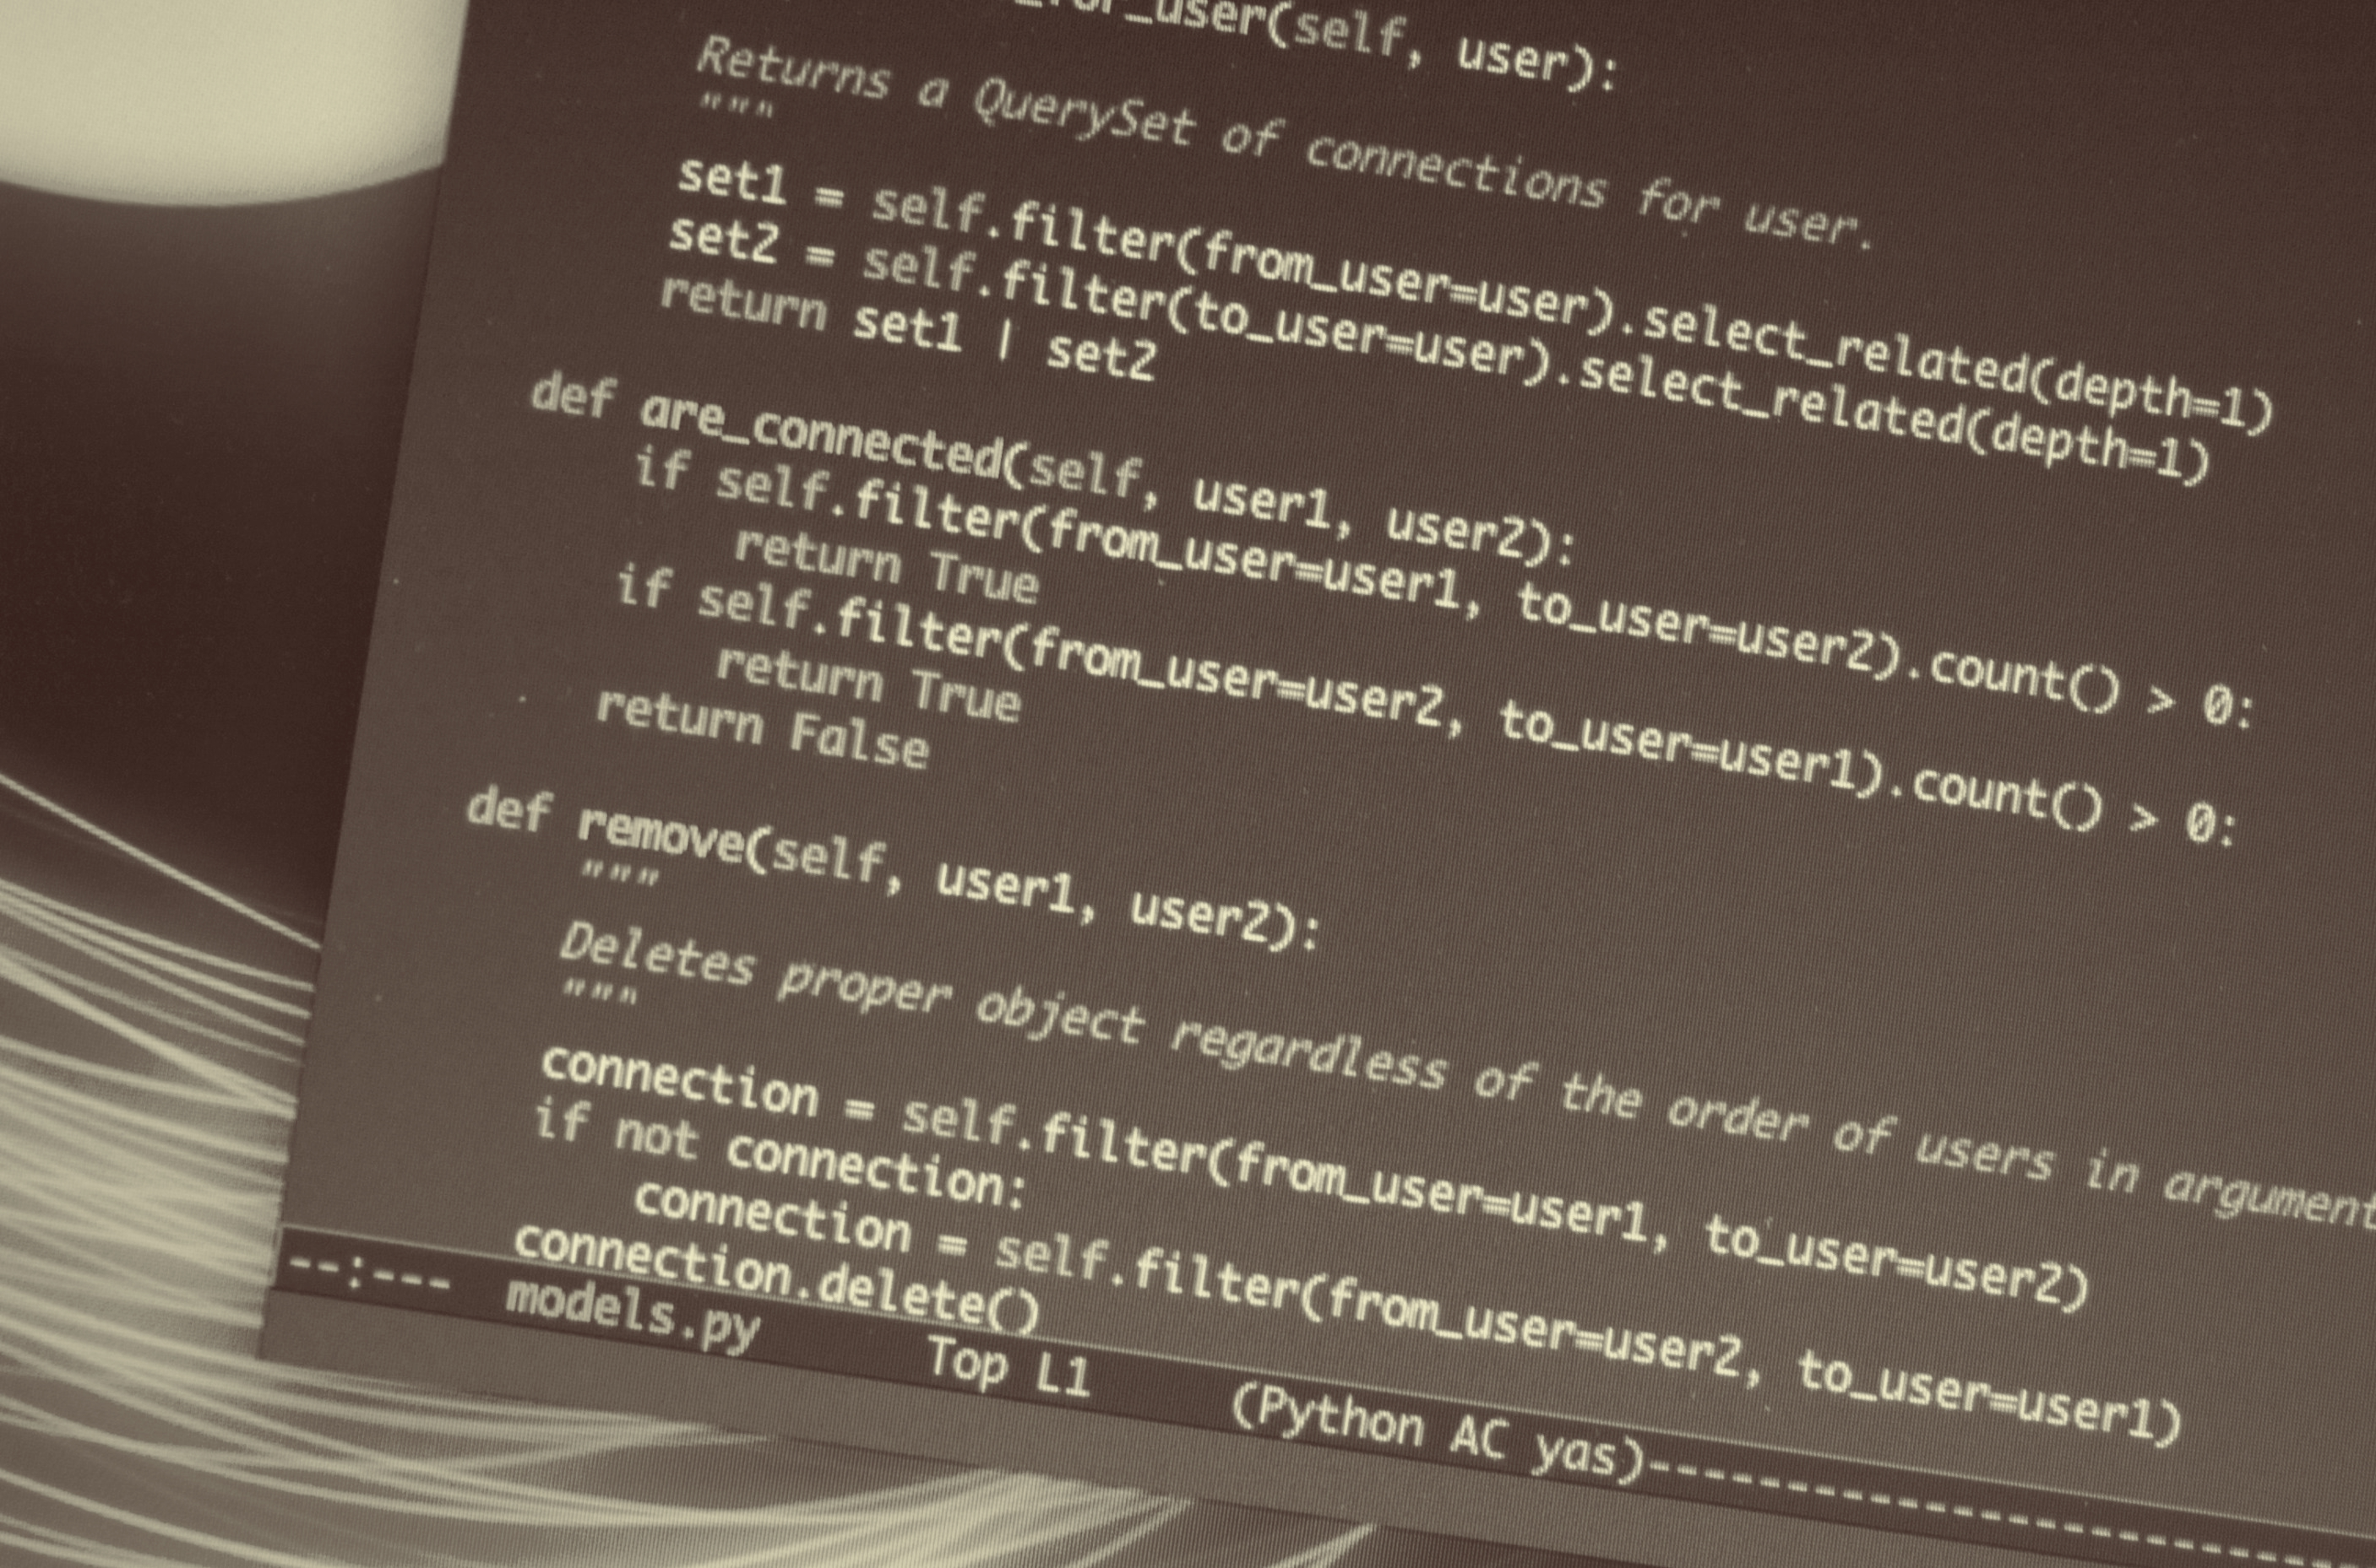
Data Acquisition & Management (AIM 5001)

